Slide 1
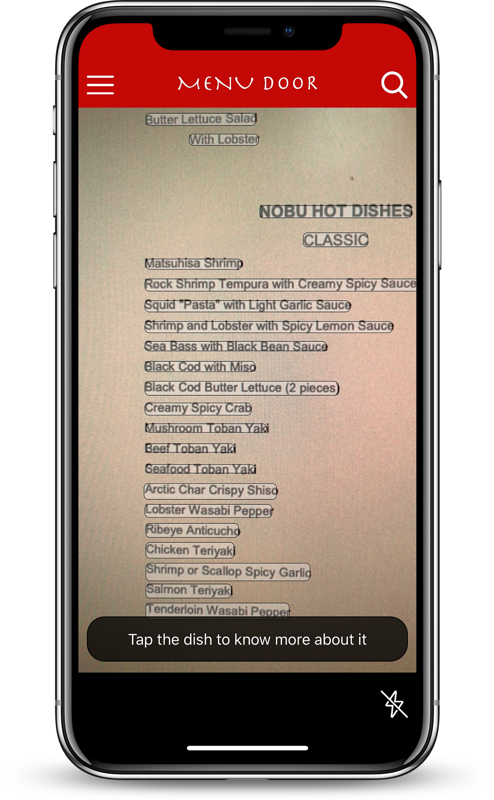
Explore any dish on the menu using your camera

Slide 2
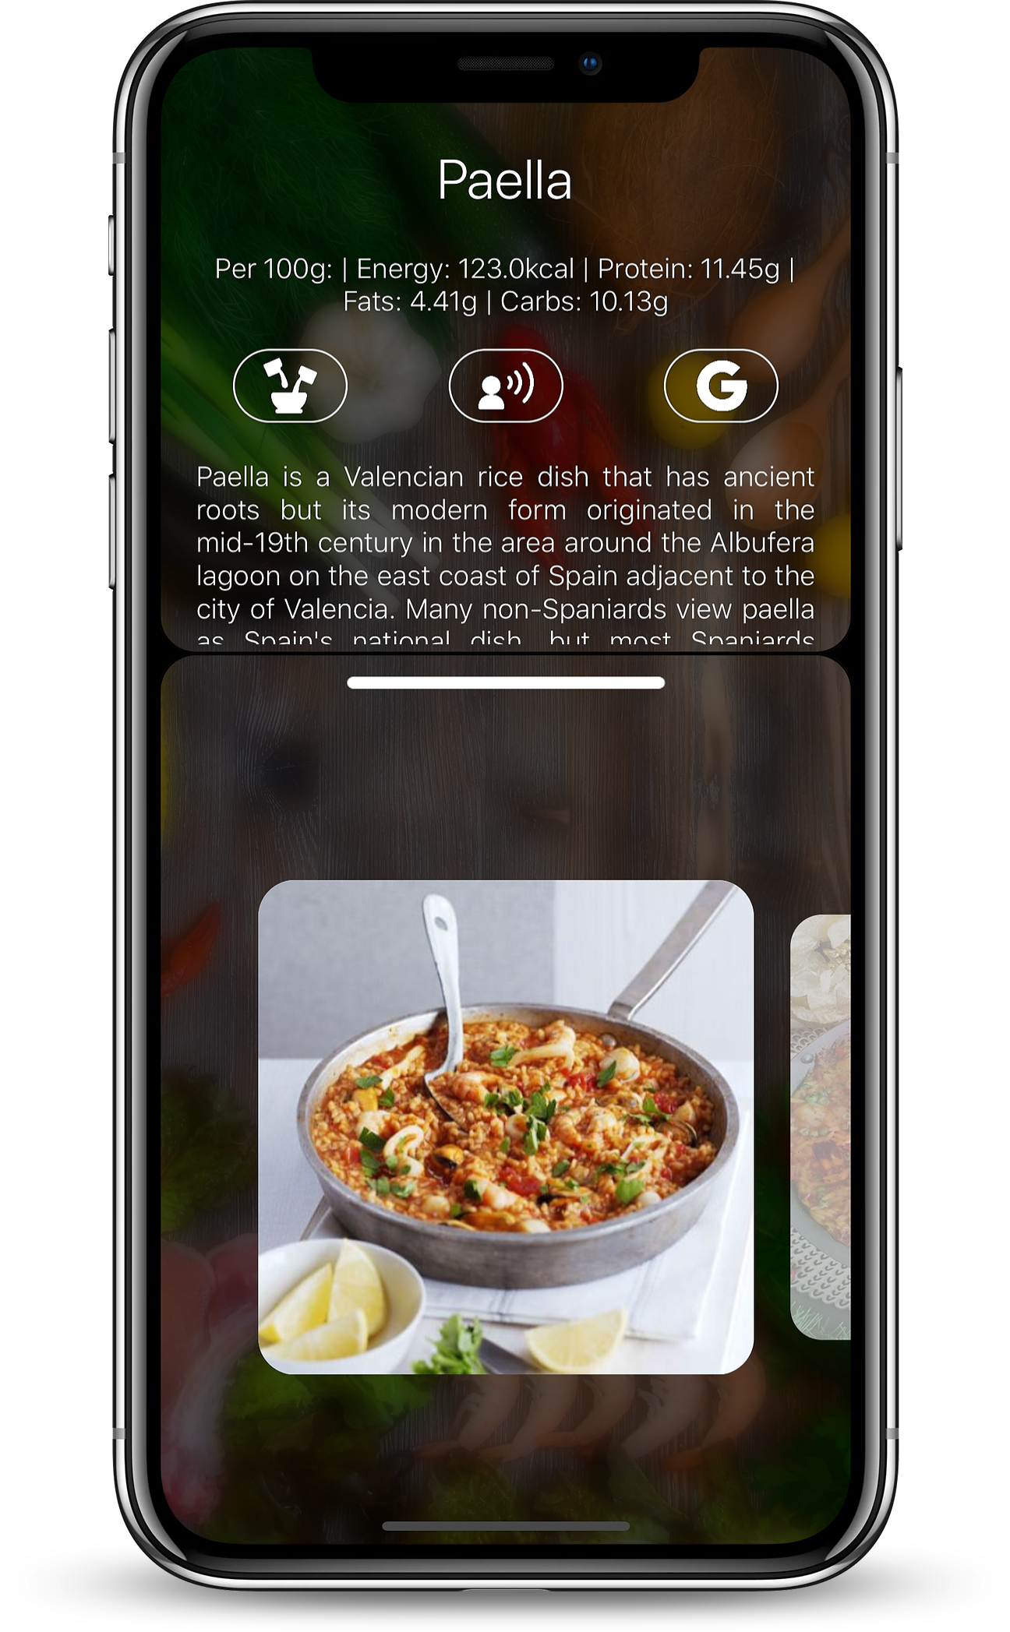
Learn about the nutritional content, ingredients and more

Slide 3
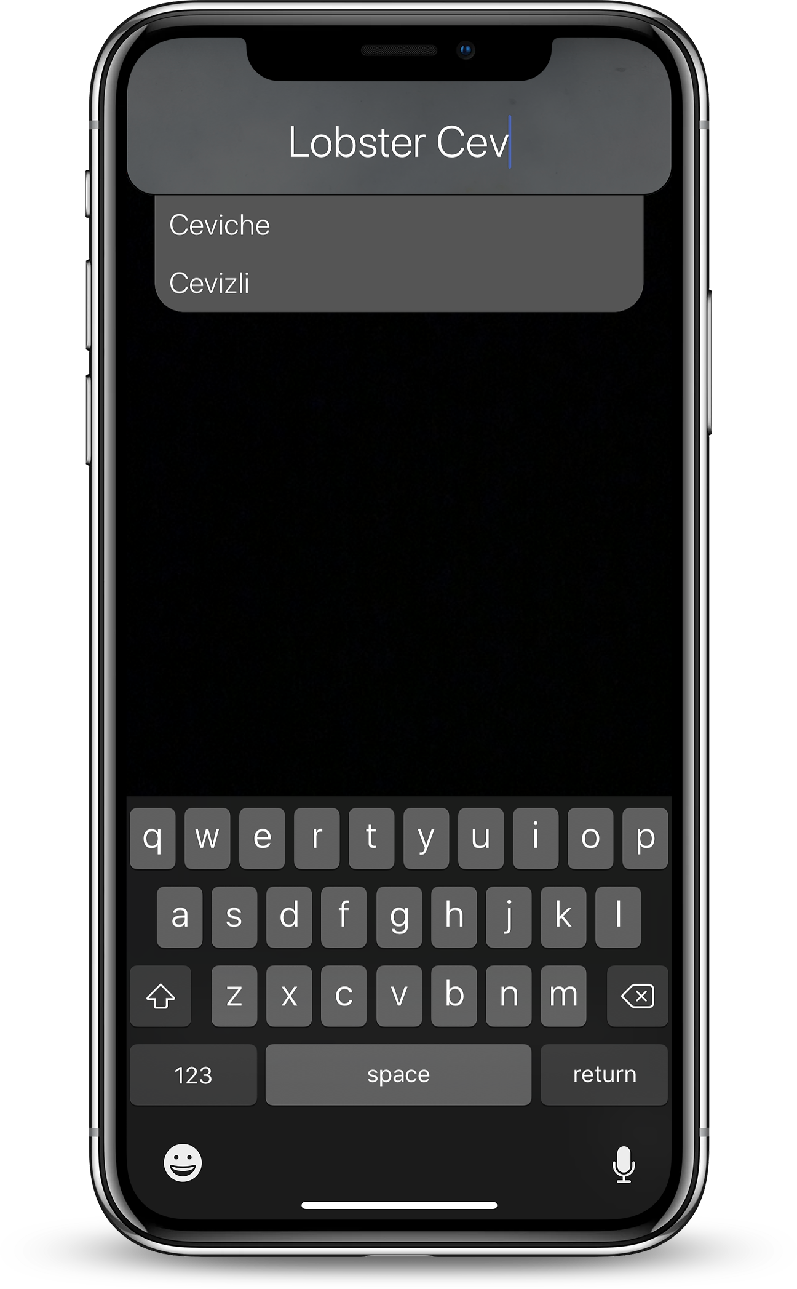
Thinking about a dish? Search it at Menu Door

Slide 4
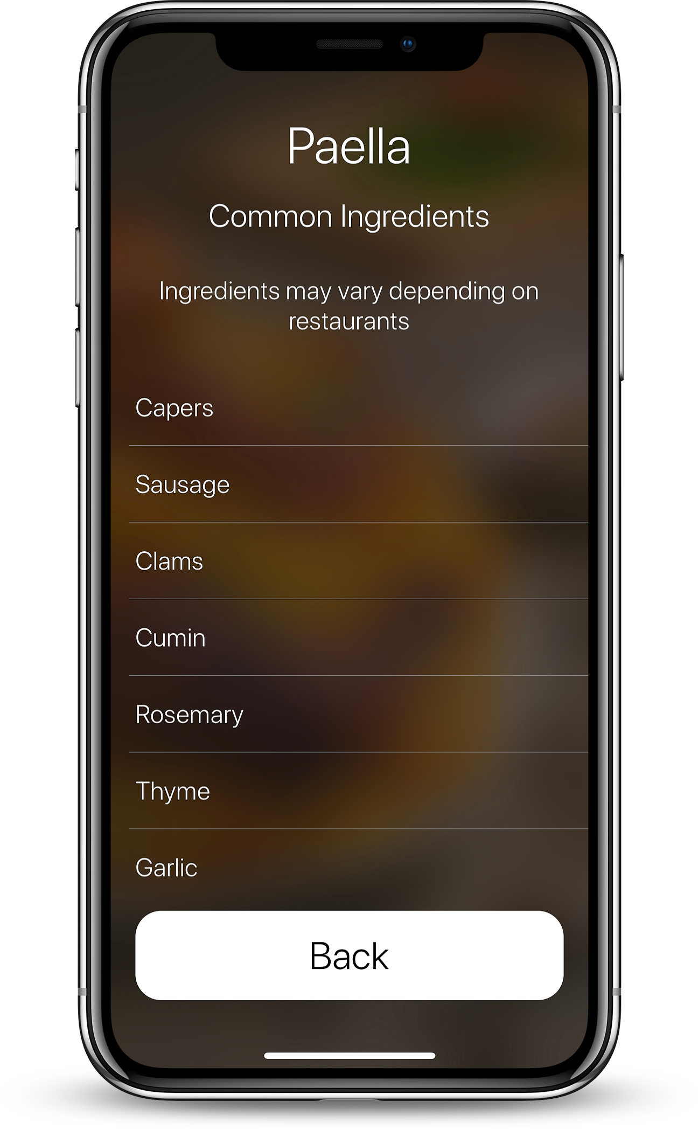
Discover the ingredients of any dish

Slide 5
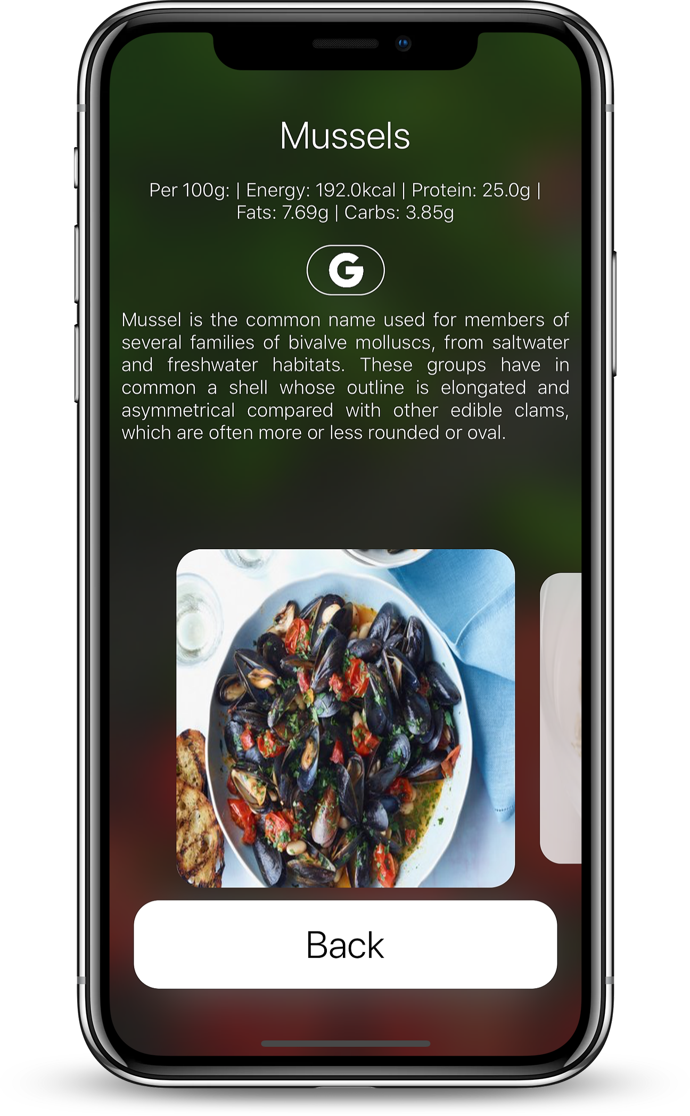
Find out in detail about each ingredient

